Slide 1
Memos and how to Write Them

Slide 2
APK
Have you ever had to remind a friend about something important or did you ever plan or organize an event and needed to remind others to be there on time?

Slide 3
ESSENTIAL question
What is a memo?
What are parts of a memo?
How do I write a memo?

Slide 4
The word “memo” is short for memorandum
A memo is: a short written communication that is often used in the workplace to provide information or ask for some form of action to take place.

Slide 5
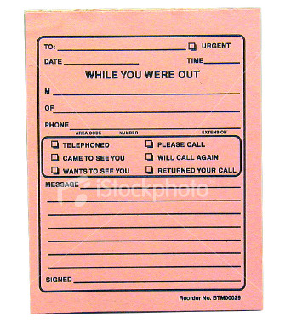
In its simplest form, a memo can look like a post-it, an email, or a secretary’s note saying that someone called and needs to be called back.

Slide 6
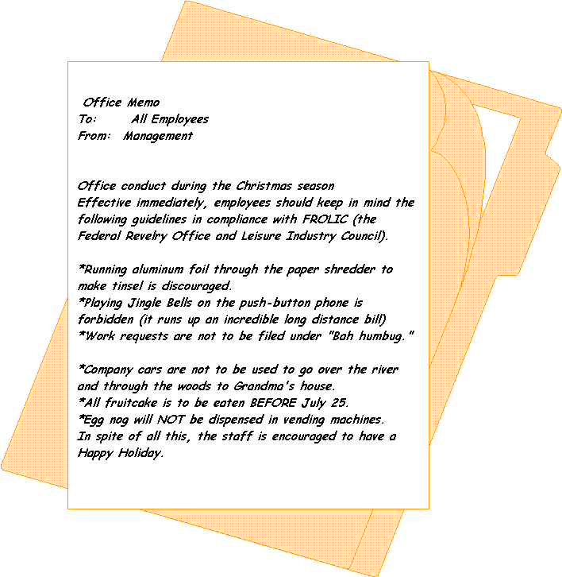
You may, however, be asked to write longer and more complex memos in the future (e.g. high school, college, or workplace), so it’s important to know how they should look and what to put in them.

Slide 7
Key Points:
As with all written documents, you must first consider your audience.
A memo generally goes to many people in a workplace; like any office document it should not read like a personal correspondence (e.g. personal letters or e-mails).
The purpose of a memo is to get a desired result, so the most important element of a memo is clarity (making sure it is easily understood).

Slide 8
Parts of a Memo:
Heading:
DATE: (complete and current date)
TO: (readers' names and job titles)
FROM: (your name and job title)
SUBJECT: (what the memo is about)
Opening - state purpose of memo, give the facts.
Summary - Explain the situation in more detail if needed.
Discussion - Any other info you need to present? Now’s your chance.
Closing - Make a courteous closing statement. Do NOT use “sincerely” or other letter-like ending.
6. Necessary attachments - include any as needed (attachments are additional information)

Slide 9
Sample Memo
Date: March 18th, 2015
To: Liberal Arts Division Faculty
From: Maintenance Dept.
Re: New Bookshelves
_________________
As many of you know, the current office bookshelves do not accommodate text books of a standard height. To correct this problem, all faculty offices will be furnished with new shelves on March 23rd, 2007 between 9:00am and 4:00pm.
We apologize for any noise or disruption this installation will cause. Faculty may schedule office hours in alternate locations as needed.
Call Mike Dill at ext. 3397 if you have questions.
Thank you for your compliance.
Heading
Opening
Summary
Discussion
Conclusion

Slide 10
Sample Memo
Heading
Date: March 18th, 2007
To: Amnesty International Members
From: Amnesty International
Re: Human Rights Day - April 13th
_________________
April 13th is human rights day. Come help us support the liberation of oppressed people everywhere. An all -day event!
Join your local Amnesty chapter to raise awareness on college campuses nation-wide. Pass out flyers on ways ordinary citizens can help. Write letters to elected officials . Spend time with friends. Share food and fun for a good cause.
No one is free when a single innocent soul is caged.
Opening
Summary
Conclusion

Slide 11
Reminders:
Be specific and precise
Start by stating exactly what it is you want
Keep memos short (under one page)
Use a business-like tone
Use bulleted lists when needed if it helps make the information you’re presenting clearer
Stick to the correct format

Slide 12
Individual Practice: write a memo…
National Friendship Day
August 3, 2015;
Boiling Springs Middle School;
Ways each pack can raise awareness at BSMS
Heading, Opening, Summary, Discussion, Closing, and Necessary Attachment

Slide 13
Individual Practice: write a memo…
National Anti-Bullying Day
October 8, 2015;
Boiling Springs Middle School;
Ways each pack can raise awareness at BSMS, Spartanburg 2 District Schools, or the community.
Save your assignment on your USB drive and print it for class credit.

Slide 14
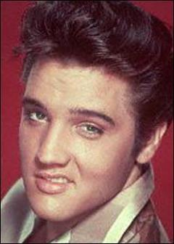
Thank you, thank you very much!
END

