Slide 1
Dress for Work Success - women

Slide 2
APK
Not knowing what to wear to an event.

Slide 3
ESSENTIAL QUESTION
What is business professional?
What is business ready?
What is business casual?
What is casual casual?

Slide 4
What are the types of Professional Dress?
Business professional
Business ready
Business casual
Casual casual

Slide 5
Making an Impression
55 % of another person’s perception of you is based on how you look.
Dress for the job you want, not the job you have.
“75% of recruiters believe that how a person dresses for work affects one's job, salary, and possible promotions”
“Your first impression is always a lasting impression”

Slide 6
Building your Professional Wardrobe
Invest your money in a great suit!
Lasts longer, timeless
Shop smart.
Think in advance, look for sales
Seek the assistance of a sales associate
Buy pieces that are versatile

Slide 7
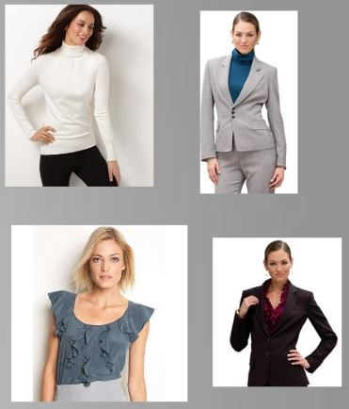
The Specifics for Women
Blouses
Tops can be button ups, turtle necks, shells, or fashion blouses.
Keep colors neutral, don’t wear loud colors or patterns.
Whatever you wear make sure it keeps you covered

Slide 8
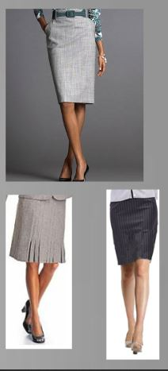
Skirts - Women
Should be a modest length, no shorter than 2 inches above the knee.
The skirt should still cover your thighs when sitting.
Make sure the skirt is appropriate for walking, climbing stairs and sitting.
Lengths can be long.
Slits are appropriate if not too long.
Skirts for professional wear should be fitting but not clingy and not flowing.
Flowing skirts are more “Casual Casual” to “Business Casual”.

Slide 9
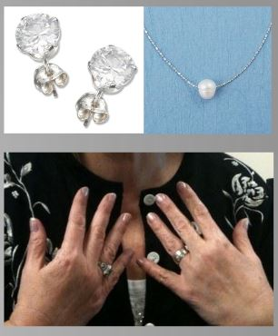
Jewelry - women
Post earrings, a modest necklace, and few rings are acceptable.
No dangling earrings, loud and noisy necklaces, or rings on every finger.
Keep the ring count down to one per hand.
Broaches are acceptable to add a little color to a jacket or sweater.

Slide 10
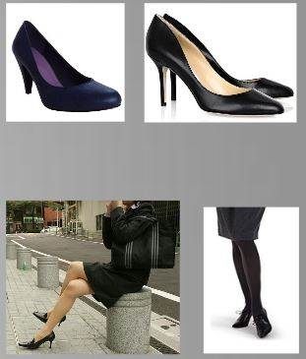
Shoes - women
Must be clean and polished.
Wear comfortable ones.
Heels should be no higher than two inches.
Closed toe pumps are preferred, however open toed shoes are acceptable for a more casual look.

Slide 11
Socks/ Hosiery - women
The only requirement of socks is that they match the color of your shoes and slacks, and that they cover your ankles and/or reach mid calf.
Hosiery must be worn with skirts.
Hosiery must be plain, neutral colored.
Exposing skin due to short socks or no hosiery is not professional.

Slide 12
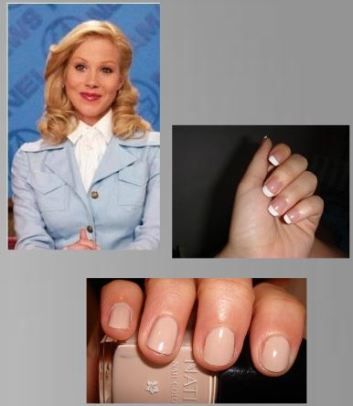
Grooming
Keep hair out of your face and brushed.
Nails should be painted a natural color, don’t match your nails to your outfit.
Makeup should look natural, and clean.
Too much color can be distracting.
keep nails, and teeth well maintained.

Slide 13
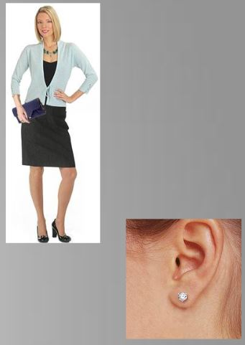
Accessories & Body Modifications
Accessories:
Should be kept to a minimum.
handbags should match your outfit, as well as scarves and/or belts.
Tattoos
Tattoos should be covered, whether with clothing, shoes or make up.
the only piercings allowed are one hole on each ear.
Any other type of piercing should be covered or removed.
Think wisely before you get something done even if you get your nose pierced you will still have a scar your employer might see.

Slide 14
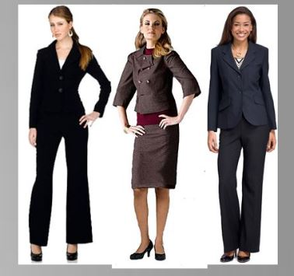
Business Professional
Think like what you would wear for an interview
Slacks or a modest skirt, a matching jacket, a button up shirt or equivalent blouse, closed toe plain heels
Sweaters are allowed if you have a nice button up shirt underneath

Slide 15
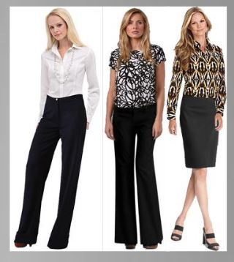
Business Ready
“Business Ready” is defined by being one simple change away from business professional.
Taking over as the new “Business Casual”
By keeping a neutral colored jacket and a pair of polished shoes in your office you can be “Business Professional” in minutes
Modest skirt or pants and an appropriate blouse
By adding a jacket and closed toe black pumps you have a complete outfit.

Slide 16
Business Casual
Very hard to define, each office has a different point of view
Ask your coworkers.
Ranges from not wearing a jacket, to wearing jeans and sandals.
Our advice: Keep it neutral, keep it covered, keep it classy.

Slide 17
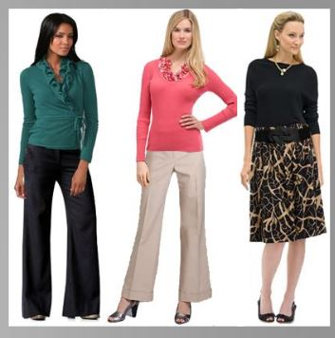
Business Casual
Wear some neutral colors, but add one pop of color for a more casual look.
Staying covered is always always always a safe bet
Do not wear a low neckline or a mini skirt
Keep your attire classy and timeless
Don’t experiment with new clothes or radical colors

Slide 18
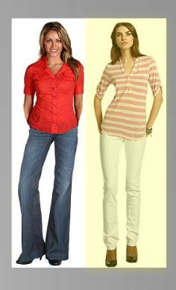
Casual Casual
Think of what to wear at a company picnic
Includes: Jeans, casual pants, t-shirts, tennis shoes
DOES NOT include: Short shorts, spaghetti Strap tank tops, tube tops, or shirts with profanity or graphics
Know what is appropriate!

Slide 19
DO’s and DON’TS – Men and women
DO:
Wear deodorant, brush your teeth, trim and polish nails, brush your hair
Wear appropriate jewelry
Wear natural looking makeup
Don’t:
Don’t wear overpowering cologne or perfume
Don’t try out elaborate hairstyles
Don’t wear trendy clothing, keep it classic

Slide 20
Guided practice
Make a pic collage displaying 3 pictures for each type of dress:
Business professional
Business ready
Business casual
Casual Casual

Slide 21
Independent practice
On a HALF sheet of paper with your name on it, write one paragraph (minimum of 5 sentences) explaining three important things you learned today.
Remember to turn it in.

