Slide 1
Dress for Work Success - men

Slide 2
APK
Not knowing what to wear to an event.

Slide 3
ESSENTIAL QUESTION
What is business professional?
What is business ready?
What is business casual?
What is casual casual?

Slide 4
What are the types of Professional Dress?
Business professional
Business ready
Business casual
Casual casual

Slide 5
Making an Impression
55 % of another person’s perception of you is based on how you look.
Dress for the job you want, not the job you have.
“75% of recruiters believe that how a person dresses for work affects one's job, salary, and possible promotions”
“Your first impression is always a lasting impression”

Slide 6
Building your Professional Wardrobe
Invest your money in a great suit!
Lasts longer, timeless
Shop smart.
Think in advance, look for sales
Seek the assistance of a sales associate
Buy pieces that are versatile

Slide 7
The Specifics for men
Buy the essentials
Button up shirts, a dark and light pair of slacks, dark dress shoes and a simple belt.

Slide 8
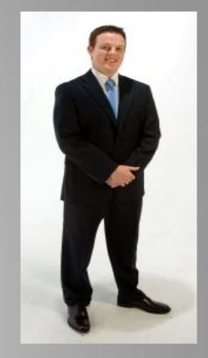
Suits - men
Suits
Pants with a matching jacket
Best material is pure wool or a wool blend.
As for color, navy, charcoal gray and black are all acceptable.
Patterns, if any, should be muted.
Choose a conservative style that is versatile.
Shirts
Best material is cotton or cotton blend.
Long sleeve shirts are more professional than short sleeve.

Slide 9
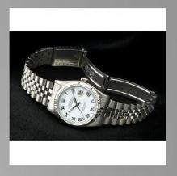
Jewelry - men
Jewelry Keep to a minimum
Wedding bands and a watch are a maximum.
Watches if warn should be conservative and not flashy.
No earrings or bracelets.
Ties
Ties should reach the top of your belt buckle.
If you don’t know how to tie a tie correctly, learn or have someone help you.

Slide 10
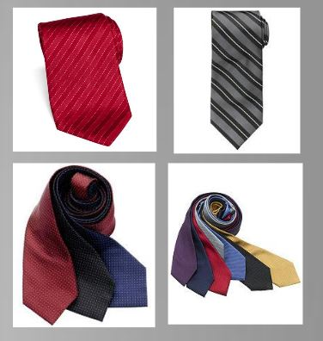
How to build a tie wardrobe - men
Buy quality ties.
Those made from 100% silk, stain resistant
They do not wrinkle
Patterns
Geometric, diagonal stripe, small to medium dotted, or solid tie
Colors
Compliment your suit
Enhance your appearance, do not over power it

Slide 11
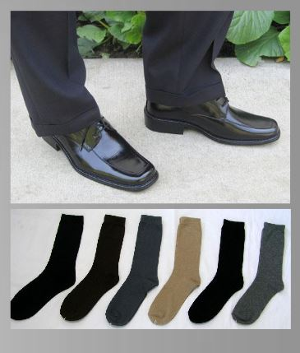
Shoes- men
Shoes
Best material is leather.
Shoes can be with or without shoe ties.
Socks
the only requirement of socks is that they match the color of your shoes and slacks, and that they cover or reach mid calf.
Exposing skin due to short socks is not professional

Slide 12
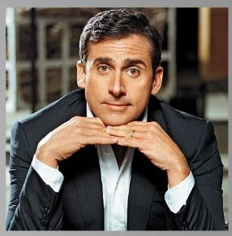
Grooming
keep hair, nails, and teeth well maintained,
hair should be short and well kept.
Get a nice hair cut.
Beards and mustaches project a less professional image.

Slide 13
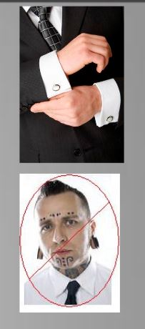
Accessories & Body Modifications
Accessories:
Should be kept to a minimum.
Men: vests, cuff links, and ties should match the rest of your outfit, but don’t wear all at once.
Tattoos
tattoos should be covered, whether with clothing, shoes or make up. Piercings.
Think wisely before you get something done even if you get your nose pierced you will still have a scar your employer might see.
Men should have no piercings visible.

Slide 14
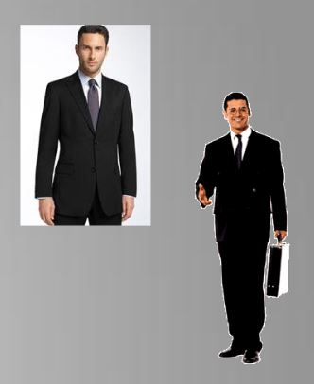
Business Professional
Think like what you would wear for an interview
Shirt and tie is required
A suit is preferred but you can wear a blazer

Slide 15
Business Professional
The goal for business professional is to look the best you can
You may be meeting new clients or representing your firm at an event
The way you dress represents you and your company
Rule of thumb: If you have to question an item, don’t wear it.

Slide 16
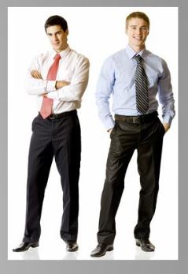
Business Ready
“Business Ready” is defined by being one simple change away from business professional.
Taking over as the new “Business Casual”
By keeping a neutral colored jacket and a pair of polished shoes in your office you can be “Business Professional” in minutes
Nice slacks, button up shirt and tie
By adding a jacket and polished shoes you have a complete outfit

Slide 17
Business Casual
Very hard to define, each office has a different point of view
Ask your coworkers.
Ranges from not wearing a jacket, to wearing jeans and sandals.
Our advice: Keep it neutral, keep it covered, keep it classy.

Slide 18
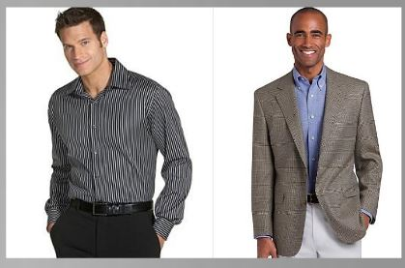
Business Casual
It might mean wearing a polo instead of a button up shirt
Tie not needed
You can step away from the basic colors of blue, white and gray slightly
Light pastel colors are acceptable

Slide 19
Business Casual
You don’t want to be too casual, but you also don’t want to be too dressy.
If you show up to work in a full three piece suit on a casual day people will have their opinions about your dress as well.
Most important thing:
Know what is appropriate
If you don’t know ask!
Most businesses will have their clothing guidelines outlined in the employee handbook.

Slide 20
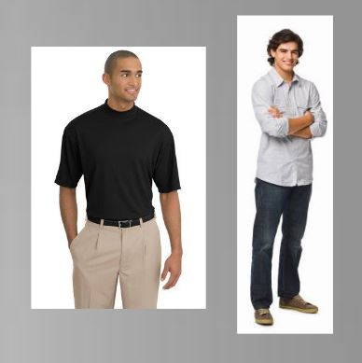
Casual Casual
Think of what to wear at a company picnic
Includes: Plain t-shirt or polo with khakis, jeans, or shorts.
DOES NOT include: Short shorts or shirts with profanity or graphics

Slide 21
DO’s and DON’TS – Men and women
DO:
Wear deodorant, brush your teeth, trim and polish nails, brush your hair
Wear appropriate jewelry
Wear natural looking makeup
Don’t:
Don’t wear overpowering cologne or perfume
Don’t try out elaborate hairstyles
Don’t wear trendy clothing, keep it classic

Slide 22
Guided practice
Make a pic collage displaying 3 pictures for each type of dress:
Business professional
Business ready
Business casual
Casual Casual

Slide 23
Independent practice
On a HALF sheet of paper with your name on it, write one paragraph (minimum of 5 sentences) explaining three important things you learned today.
Remember to turn it in.

